Slide 1
HOMEWORK 2
Marketing Analytics - IST 653
November 20, 2023
Anna Khairi
Logan Roach
Mark Stiles
Oliver Gunn
Sachi Singh
Notes:
Anna

Slide 2
OBJECTIVES
SEGMENT INSIGHTS
1
TEST/TRAIN SPLIT LOGIC
2
BASE MODEL
3
OPTIMIZED MODEL
4
CUSTOM MODEL
5
RECOMMENDATIONS
6
ADDITIONAL DATA
7
Notes:
Anna

Slide 3
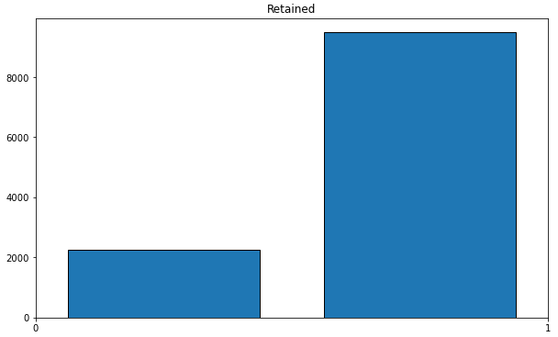
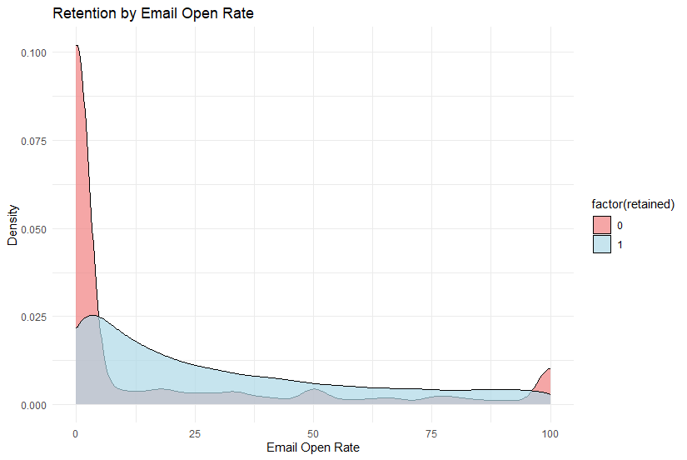
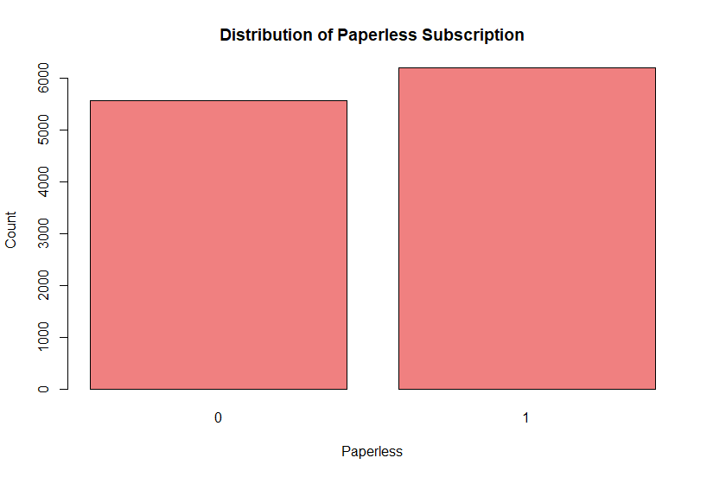
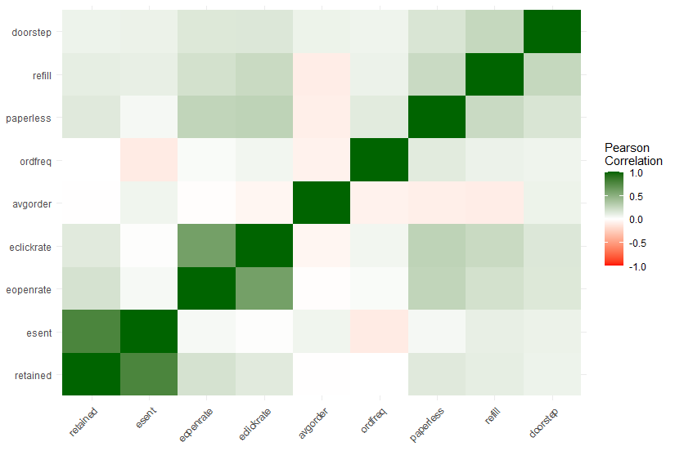
SEGMENT INSIGHTS: Q1s & Q2s
Notes:
The retail relay data set consist of 14 variables and 11760 observations. Data exploration will show up any obvious relations between variables
1. Understanding the Data Structure and Quality: Before any analysis, it's essential to understand what the data looks like. Data exploration helps identify the structure of the dataset, types of variables (categorical, numerical), missing values, and any anomalies or outliers. This understanding is crucial for making informed decisions about data cleaning and preparation.
2. Uncovering Patterns and Relationships: Exploratory data analysis (EDA) allows you to discover patterns, relationships, and correlations within the data. These insights can guide more detailed analysis and help form hypotheses for statistical testing.
3. Informing Model Selection and Feature Engineering: Insights gained from EDA are valuable in selecting appropriate models and techniques for further analysis. Additionally, understanding the relationships between variables can guide the creation of new features (feature engineering) that improve model performance.
4. Identifying Potential Issues: During EDA, you might uncover issues that need to be addressed before moving on to more complex analyses, such as biases in the data, inappropriate data types, or incorrect values.

Slide 4
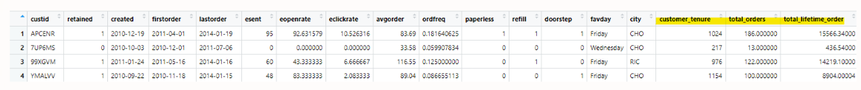
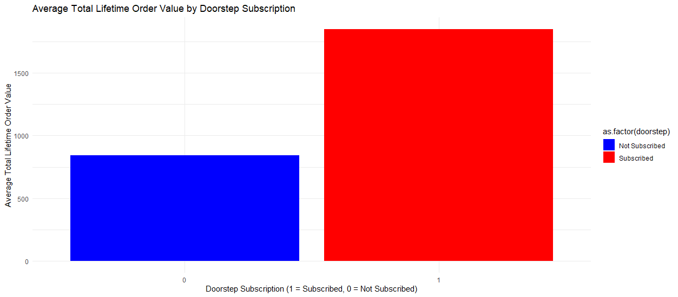
SEGMENT INSIGHTS: Q1s & Q2s
(CONTINUED)
 | Tenure (Days) | Total Orders | Total Dollars Spent Lifetime | Average Order Price
Not Retained- 0 | 241 | 10.6 | $902 | $73.30
Retained - 1 | 236 | 10.5 | $906 | $73.00
Notes:
After taking a careful look at at the data, i review the data dictionary and realized ordfreq was calculated by Number of orders by customer tenure. I worked back and figured out that if you calculate the customer tenure which is the time between first order and second order then multiply it by the ordfreq you will get the exact total_orders made by each customer, i took it a step further and multiple the total order by avg order which gave me the Total amount spent as a customer. To gain some quick insight i averaged out the total order made, total dollars spent lifetime and average order price and got ……I ran through a view different explorations and found that most interesting was the doorstep subscription. Customers who had no doorstep subscription spent less than of those with door stop subscription. As we move on to the models, the variable total orders made will play a role.

Slide 5
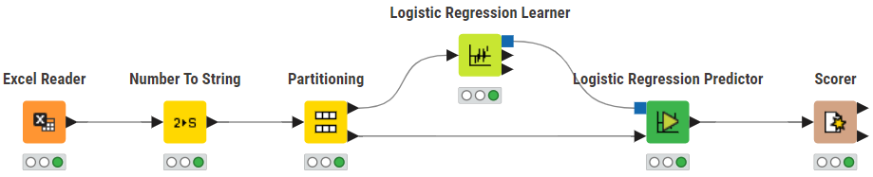
MODEL
RANDOM SPLIT 70/30
Notes:
Logan
Split the data 70% for training and 30% for testing
Using Knime the data was read in, processed and partitioned. Then the partitions were used to train and test the model where the Scorer module gives us information about the models coefficient and accuracy

Slide 6
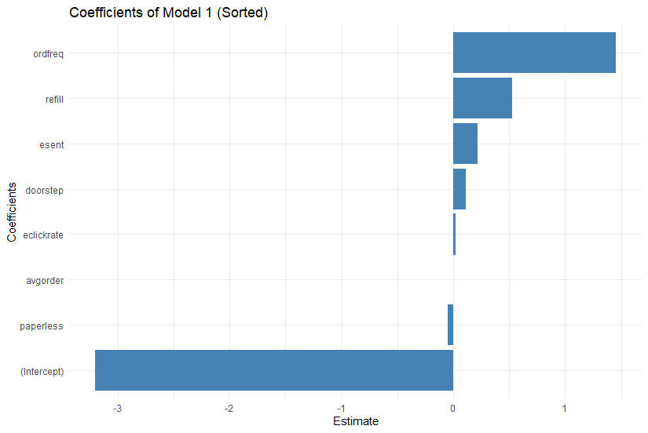
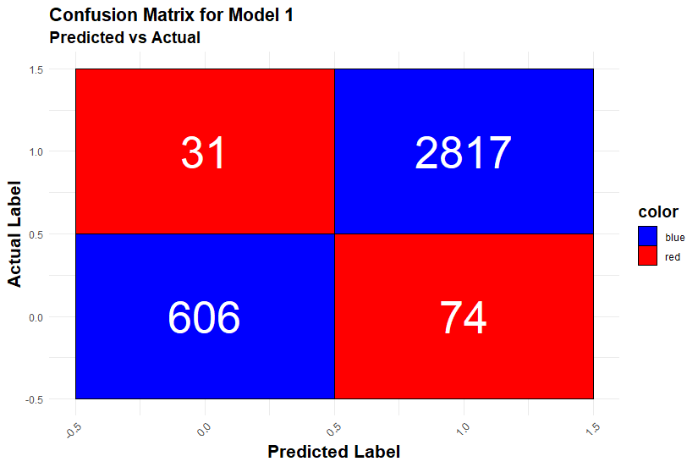
BASE MODEL:
LOGISTIC REGRESSION
Variable | Coefficient | Interpretation
intercept | -3.217 | Constant value / not a variable
esent | 0.224 | Positive odds of retention
eclickrate | 0.021 | Slightly increased retention odds
avgorder | -0.003 | Virtually no effect
ordfreq | 1.447 | Largest magnitude increase on retention odds
paperless | -0.009 | Negligible dependent variable
refill | 0.322 | Significantly increased odds of retention
doorstep | 0.164 | Improved retention odds
HIT RATE: 97.1%
Notes:
Logan
Results for our initial model, what we are calling our Base Model
The intercept is our starting point, a constant that represents the log odds of retaining a customer when all other variables are 0
Order Frequency was the coefficient with the largest impact on customer retention
The coefficients marked with orange were the variables that also increased the retention rate
In terms of impact:
Customers using the automatic refill option (noted as refill) increases the retention because customers automatically have their order’s refilled
The amount of emails sent (noted as esent) increases the hit rate which makes sense because it increases engagement with customers
Lastly customers using the option for doorstep delivery increase the odds of retention, suggesting that customers appreciate delivery rather than transporting their groceries themselves
We will revisit some of these later in the recommendations slide
Other coefficients that had little to no impact were:
Eclickrate - the customer email response rate
Avgorder - how much customers buy at one time
Paperless- customers using paperless billing

Slide 7
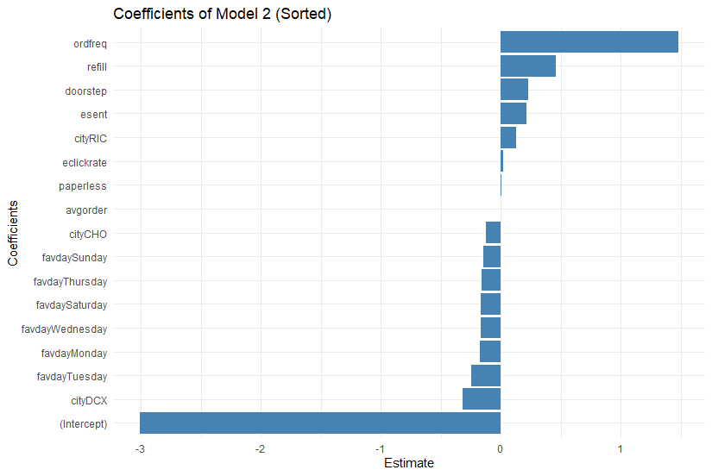
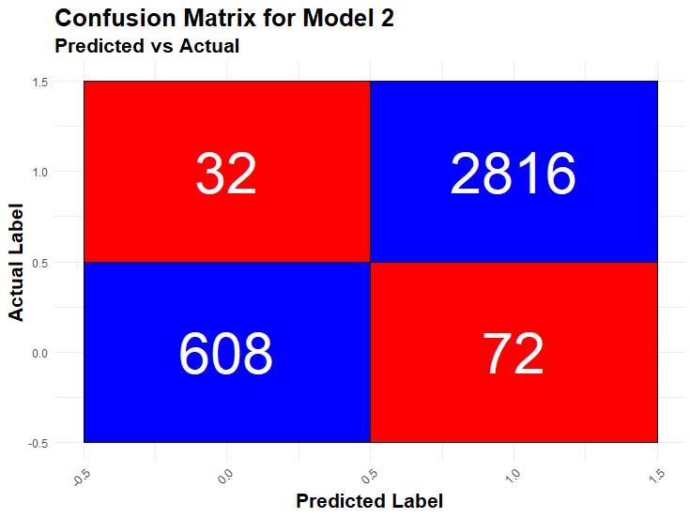
OPTIMIZED MODEL:
LOGISTIC REGRESSION
Variable | Coefficient | Interpretation
intercept | -2.936 | Increased from Base Model
esent | 0.224 | Same as Base Model
eclickrate | 0.021 | Same as Base Model
avgorder | -0.003 | Same as Base Model
ordfreq | 1.468 | Increased from Base Model
paperless | 0.189 | Increased from Base Model
refill | 0.069 | Decreased from Base Model
doorstep | 0.406 | Increased from Base Model
Monday | -0.078 | Decreased odds of retention compared to Friday
Tuesday | -0.224 | Decreased odds of retention compared to Friday
Wednesday | -0.134 | Decreased odds of retention compared to Friday
Thursday | -0.14 | Decreased odds of retention compared to Friday
Saturday | -0.404 | Decreased odds of retention compared to Friday
Sunday | -0.259 | Decreased odds of retention compared to Friday
CHO | -0.169 | Decreased odds of retention compared to BWI
DCX | -0.565 | Decreased odds of retention compared to BWI
RIC | -0.054 | Decreased odds of retention compared to BWI
HIT RATE: 97.1%
HIT RATE: 97.1%
Notes:
Mark
FaveDay Model: Favorite Day And City added as coefficients
The favourite day (customers favourite delivery day, their choice) and city metrics did not significantly change the model
People don’t know what they want (in terms of delivery)
Hit rate did not change between the base model and the new model with the favourite day and city added as additional variables

Slide 8
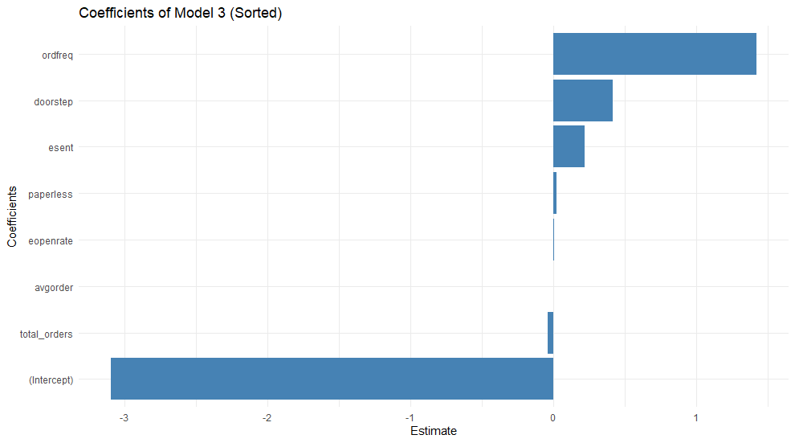
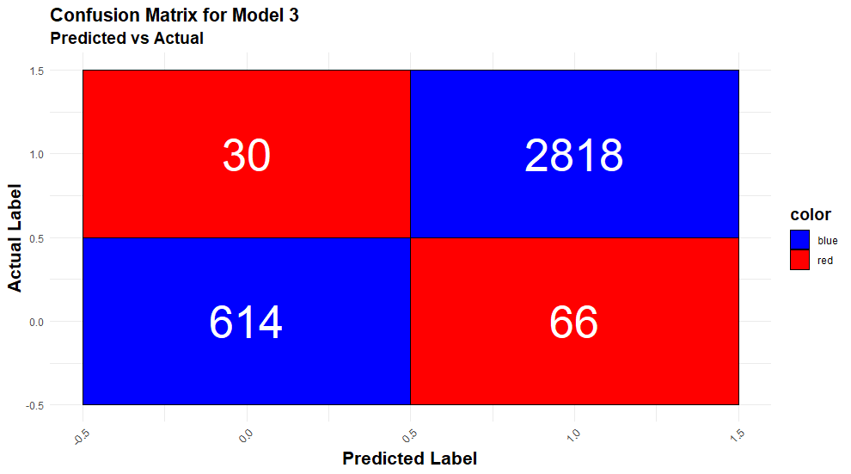
DETAILED OPTIMIZED MODEL:
LOGISTIC REGRESSION
Variable | Coefficient | Interpretation
intercept | -3.095 | Increased from Base Model
esent | 0.220 | Decreased from Base Model
ordfreq | 1.422 | Decreased from Base Model
paperless | 0.024 | Increased from Base Model
doorstep | 0.416 | Increased from Base Model
total orders made | -0.038 | Decreased odds of retention
eopenrate | -0.006 | Decreased odds of retention
avgorder | -0.0005 | Increased from Base Model
HIT RATE: 97.3%
Notes:
Mark?
Optimized/ Custom Model
Total orders made= The total number of orders each customer has during their tenure as a customer. This variable was transformed during the data exploration phase.

Slide 9
RECOMMENDATIONS
Incentivize frequent orders
Discounts & Coupons
Loyalty Programs (e.g. “Gold Club” or “Rewards” membership)
Include doorstep service free in first delivery
Increases the odds of retention by 12 - 27%
Allow customers to control the cadence of their email promo offers to drive higher retention lift without overloading customers’ inboxes
Encourage users to sign up for automatic refills
Second-highest positive impact on retention
Don’t allow orders without an account
Accounts = “stickier” customers
Logins = more customer data
1P data for re-sale and/or commerce marketing
Notes:
OLIVER

Slide 10
ADDITIONAL DATA
Demographic
Socio-Economic
→ E.g. age, race, sex
→ HHI, lifecycle stage, education, employment status, ethnicity…
Build Customer Personas
‘Bargain hunters’ → use coupons > 50% of the time
‘Silver foxes’ → customers 55+ in FL who love golf
‘Blue Mooners’ → low freq/open rates, but high order values
Customer Preference
→ Branded vs. Generic?
→ Small-batch vs. Volume discounts?
→ “Paper vs. Plastic”?
Notes:
OLIVER

Slide 11
“Our mission is to make eating quality, healthy, and sustainable food simple.”
-Relay Foods
Orange
Yellow
Red
Green
Purple
Notes:
OLIVER

